Slide 1
Polygon Filling Algorithms
Highlight all the pixels inside the polygon .2 approaches can be used
1. Scan Fill
2. Seed Fill (Boundary Fill, Flood Fill )

Slide 2
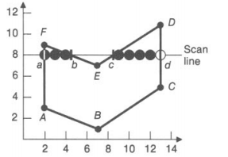
Scan Fill
Start with max y and move to min y or vice versa
For each scan line:
Find the intersections of the scan line with all edges of the polygon.
Sort the intersections by increasing x coordinate.
Fill in all pixels between pairs of intersections
For scan line number 8 the sorted list of x-coordinates is (2, 4, 9, 13) Therefore draw line b/w (2,4) & (9,13)

Slide 3
Assume that we are taking scan line from max y and moving towards min y
We know that for every scan line we have to calculate x intersection with every polygon side. We can determine the next x intersection value as
x_{i+1}=x_{i} - 1/m where m is the slope of edge

Slide 4
It is very easy to identify which polygon sides should be tested for x-intersection, if we sort edges in order of maximum y and find active edge list (Active edge list for scan line contains all the edges crossed by that scan line ).
Two pointers are used to indicate the beginning and ending of active edge list. As the scan line move down the picture the beginning and end pointers also moved down to eliminate the edges which end above the current scan line and include the new edges which now start on or above the current scan line .

Slide 5
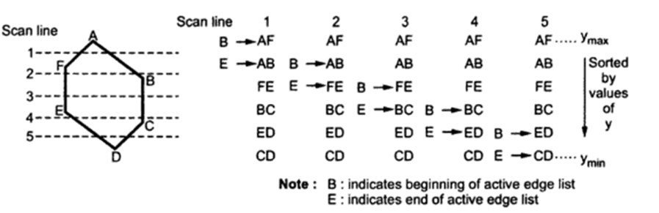

Slide 6
Boundary Fill Algorithm
This algorithm picks a point inside the polygon and starts to fill until it hits the boundary of the object.
Assumption:
In this algorithm, we assume that color of the boundary is same for the entire object.

Slide 7
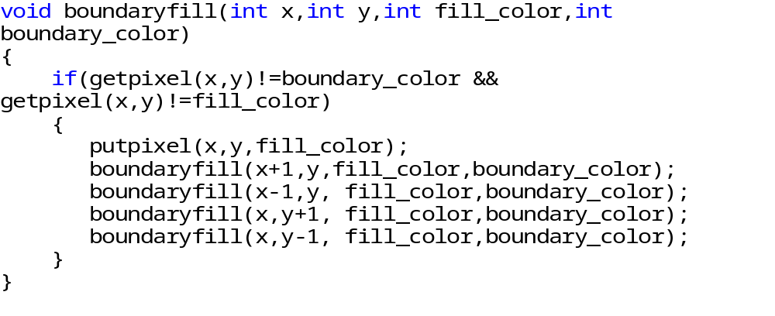
Boundary Fill Algorithm (Code)

Slide 8
Flood Fill Algorithm
Sometimes we want to fill in an area that is not defined within a single color boundary.
We paint such areas by replacing a specified interior color instead of searching for a boundary color value. This approach is called a flood-fill algorithm.

Slide 9
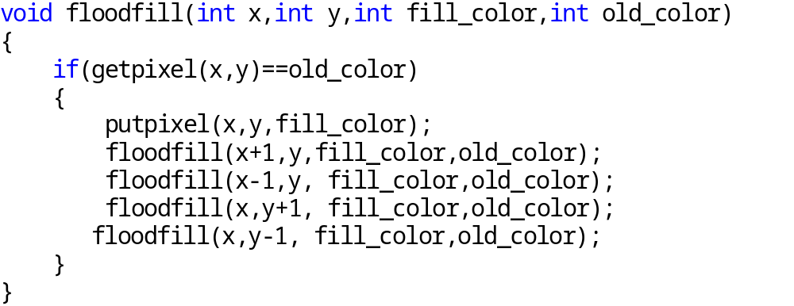
Flood Fill Algorithm (Code)

Slide 10
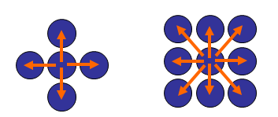
Boundary Fill Algorithm /Flood Fill algorithm
The boundary fill algorithm/ flood fill algorithm can be implemented by 4-connected pixels or 8-connected pixels.

Slide 11
4-connected (Example)
Start Position

Slide 12
3
2
1
1
2
3

Slide 13
4
2
1
1
4
2

Slide 14
2
1
1
2

Slide 15
5
1
5
1

Slide 16
1
1

Slide 17
Some region remains unfilled

Slide 18
8-connected (Example)
Start Position

Slide 19
5
4
3
2
1
4
1
5
2
3

Slide 20
6
4
3
2
1
6
4
1
2
3

Slide 21
8
7
4
3
2
1
7
8
4
1
2
3

Slide 22
12
11
10
9
7
4
3
2
1
11
9
12
7
10
4
1
2
3

Slide 23
11
10
9
7
4
3
2
1
11
9
7
10
4
1
2
3

Slide 24
10
9
7
4
3
2
1
9
7
10
4
1
2
3

Slide 25
9
7
4
3
2
1
9
7
4
1
2
3

Slide 26
7
4
3
2
1
7
4
1
2
3

Slide 27
4
3
2
1
4
1
2
3

Slide 28
3
2
1
1
2
3

Slide 29
2
1
1
2

Slide 30
1
1

